Slide 1
Traffic Safety: City of Chicago
Erika Haren
Will Skrab
Caitlin Helmer
Robert Wood

Slide 2
Project Description
Study of traffic in the City of Chicago, including congestion, crash, and traffic camera data, all of which has been made publicly available by the City of Chicago.

Slide 3
Data Sources
data.cityofchicago.org
Red Light Camera Locations
Red Light Camera Violations
Speed Camera Locations
Speed Camera Violations
Traffic Crashes – Crashes
Traffic Crashes – People
Traffic Crashes – Vehicles
Congestion Estimates by Region
www.fhwa.dot.gov (Federal Highway Administration)
Licensed driver data

Slide 4
Questions considered
In what areas are crashes more/less common?
Is there a correlation between crashes and red light cameras? Crashes and speed cameras?
What are the average congestion levels hour by hour? Do these correlate to the number of crashes?
In what areas are drunk-driving accidents more/less common?
What is the most common cause of crashes? What age driver is most likely to be involved in a crash?
Is there a correlation between cameras and severity of accidents?

Slide 5
Process
Gather data from data.cityofchicago.org, via the Socrata Open Data API (SODA) or direct .csv download
Import and review data using Jupyter Notebook and Pandas
Evaluate scope of available data (reporting years, keys to link datasets)
Clean datasets
Remove NaN and ‘0’ values
Filter timeframe of data as needed to remove partial year reporting
Parse resulting data, link dataframes to determine answers to the questions posed
Visualize data using Matplotlib and Google Maps
Run statistical analysis to determine significance

Slide 6
Chicago Data
Population of 2.716 million as of 2017
The median age is 34.4
The median Income is $53,006
There are roughly 4.5 million cars in Illinois
An estimated 55 million people visit the city annually

Slide 7
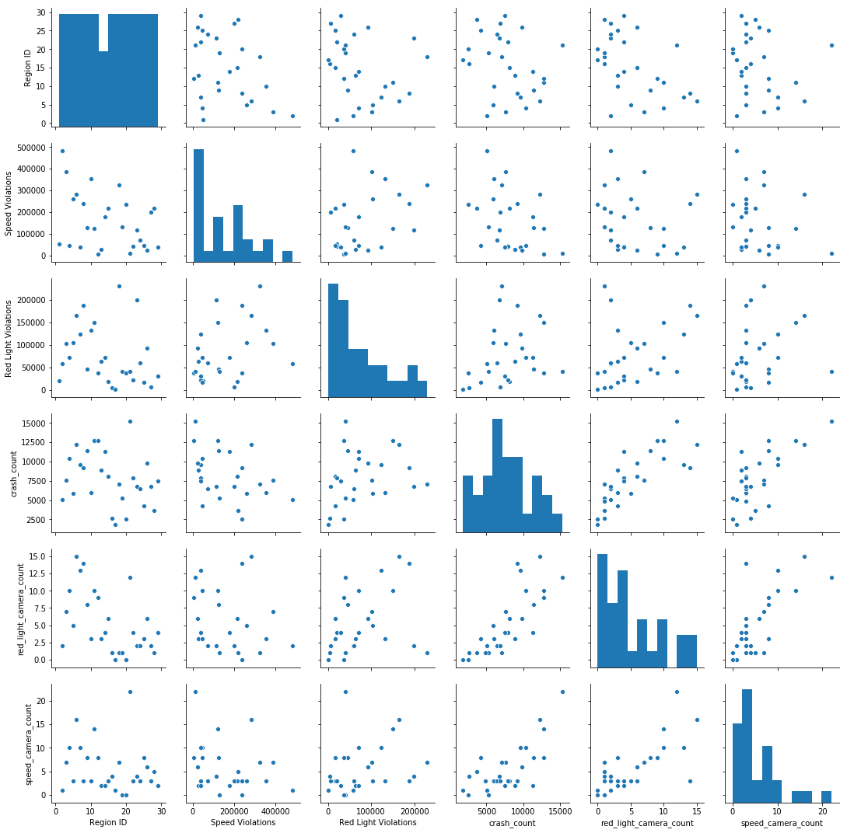
Correlation Exploration
Pair plot using available variables to visualize possible correlation
Possible correlation was observed between crash count and red light cameras, as well as crash count and speed cameras

Slide 8
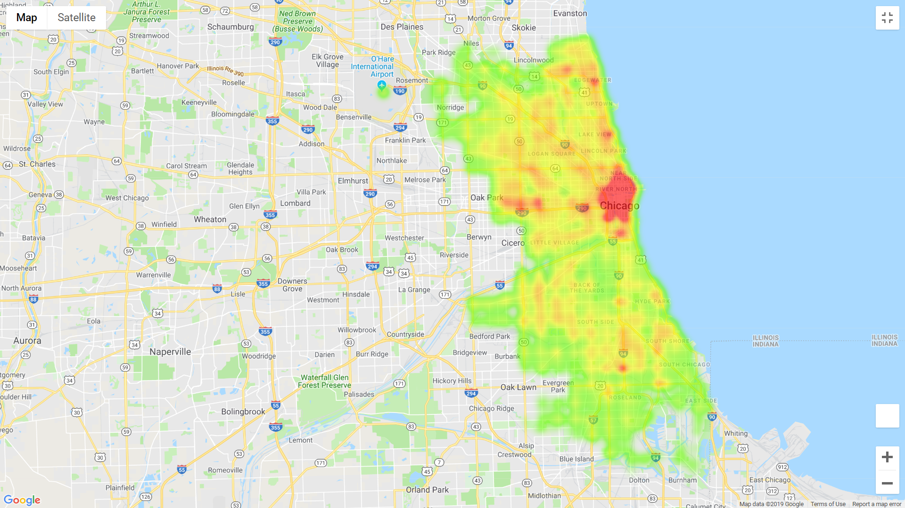
Traffic Crashes
Heatmap of traffic crashes in the City of Chicago, 2017-2018

Slide 9
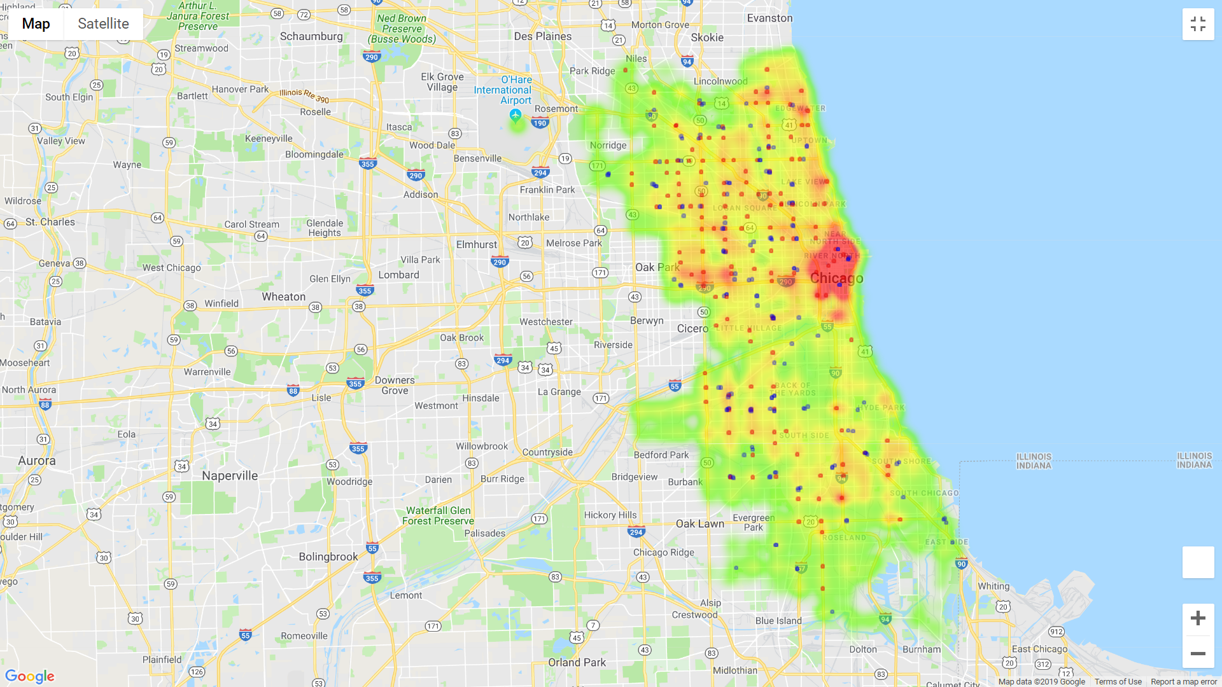
Traffic Crashes, Incl. Red Light and Speed Cameras
Red Light Cameras
Speed Cameras
Heatmap of traffic crashes in the City of Chicago, 2017-2018, including red light cameras and speed cameras

Slide 10
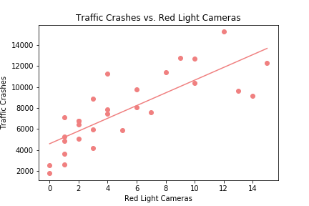
Crashes vs. Red Light Cameras
Strong correlation between number of red light cameras and crashes
r = 0.80
p = 2.35e-07
Due to lack of available crash data prior to camera installation, not possible to prove causation or effect of camera installation on crash levels

Slide 11
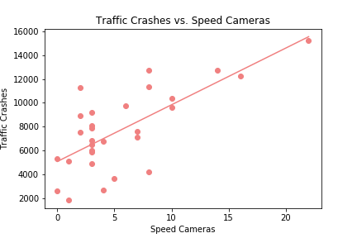
Crashes vs. Speed Cameras
Strong correlation between number of speed cameras and crashes
r = 0.71
p = 1.43e-05
Due to lack of available crash data prior to camera installation, not possible to prove causation or effect of camera installation on crash levels

Slide 12
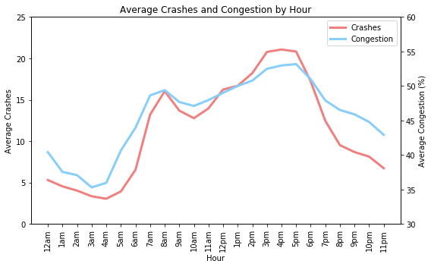
Congestion and Crashes by Time of Day
Trend shows higher congestion levels during standard morning and evening commutes, as expected
Extremely strong correlation between congestion and crashes by time of day
r = 0.95
p = 6.15e-13

Slide 13
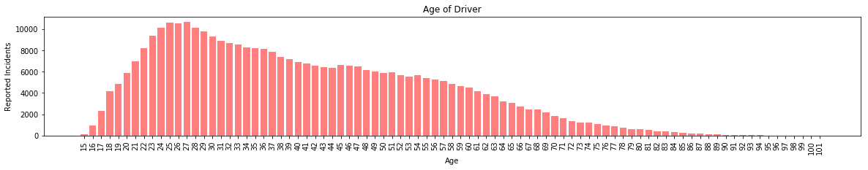
Crashes by age of driver
The average age of a driver involved in a crash in Chicago is significantly lower than the average age of all drivers in Illinois.
p-value is 0.0023588

Slide 14
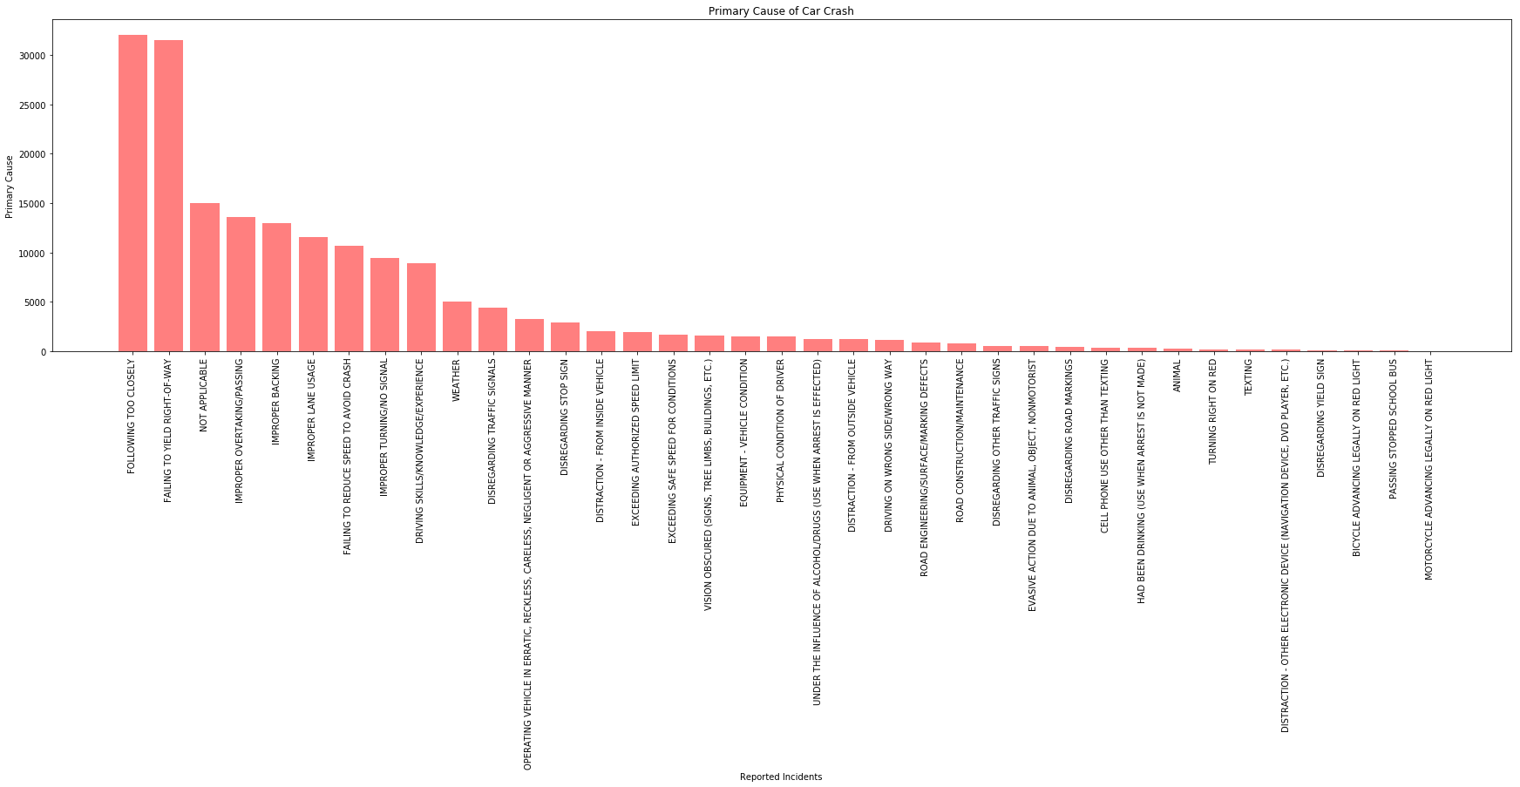

Primary Cause of Crash

Slide 15
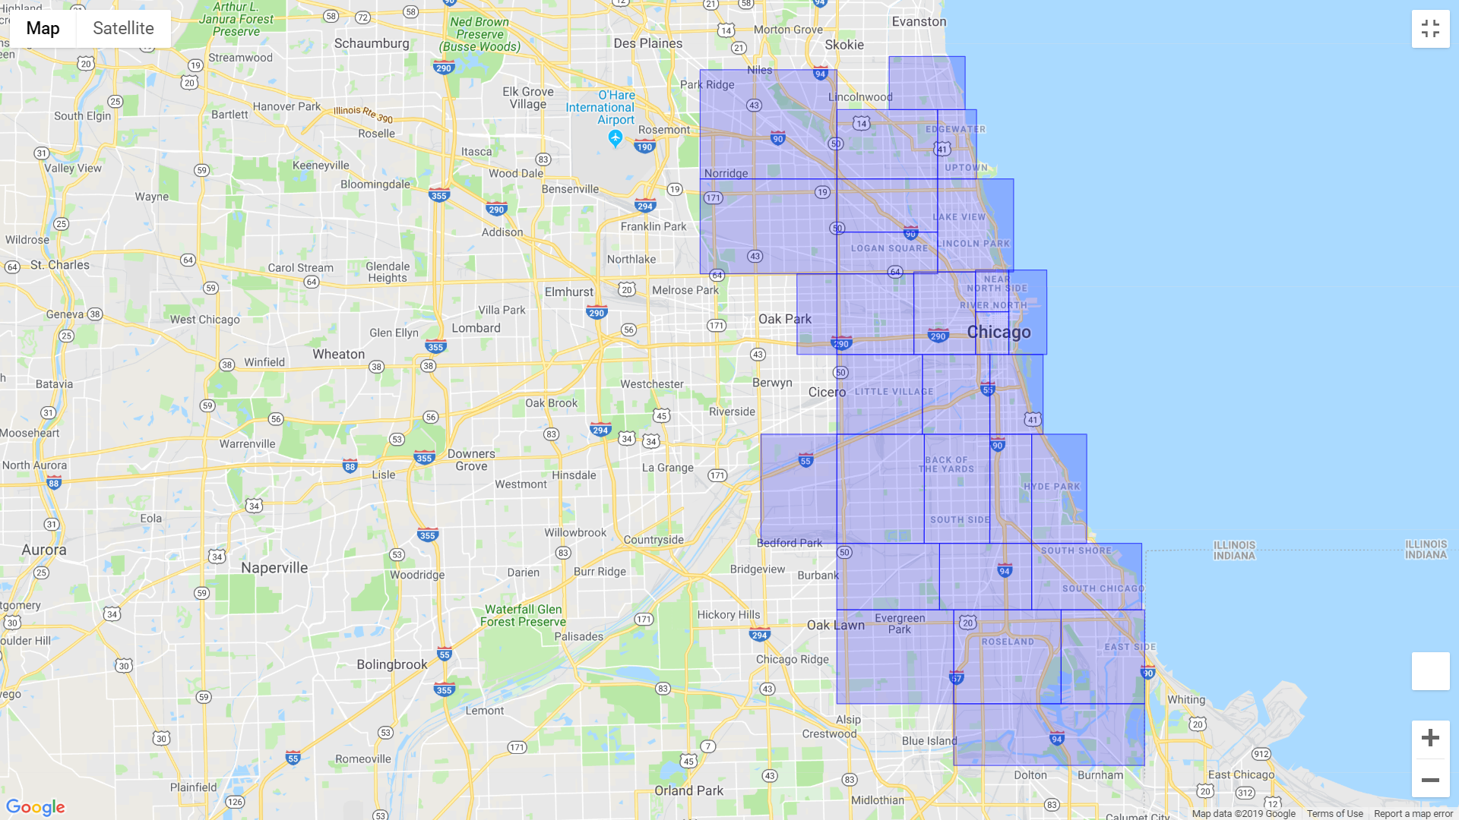
Traffic Regions
29 regions, defined by the City of Chicago

Slide 16
Traffic Regions
1
2
3
4
6
5
8
12
7
9
10
11
29
14
15
16
13
17
18
19
20
21
29 regions, defined by the City of Chicago
22
23
24
25
26
27
28

Slide 17
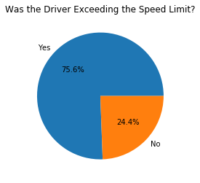
relevance of speeding to crashes

Slide 18
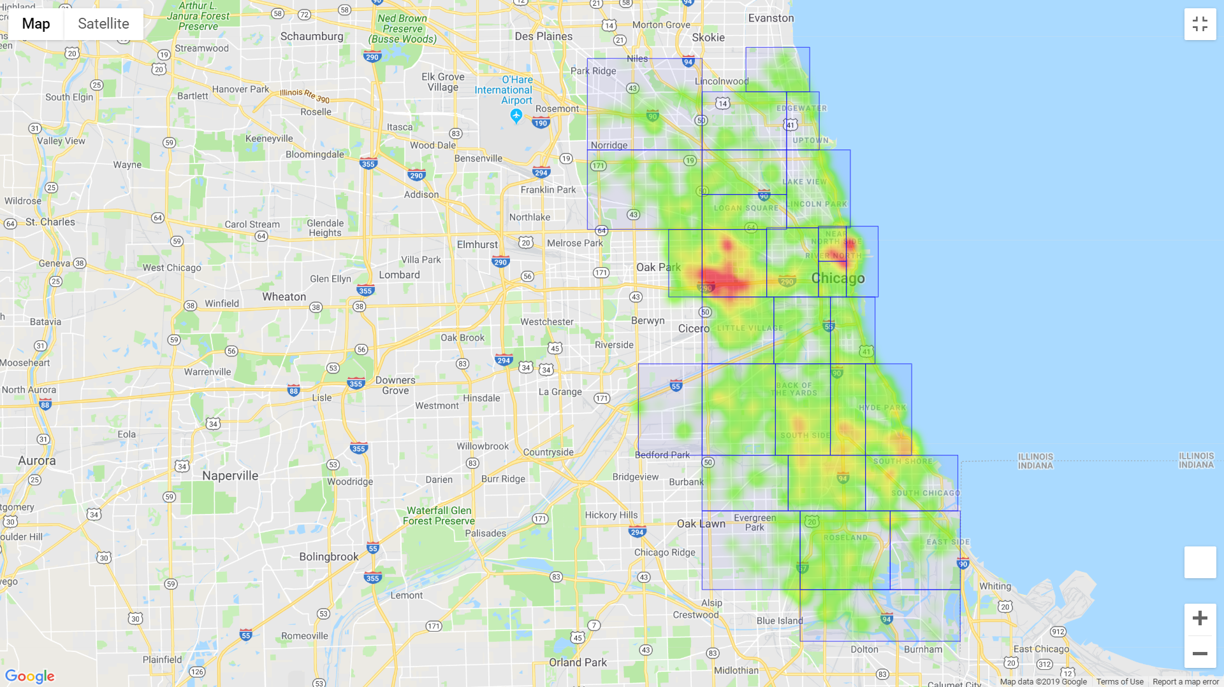
Traffic crashes, Speeding
Heatmap of crashes in which the driver was exceeding the speed limit

Slide 19
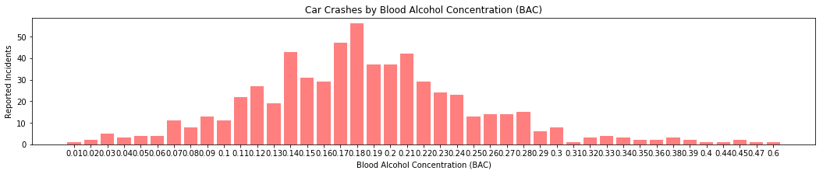
Crashes by Blood Alcohol Concentration

Slide 20
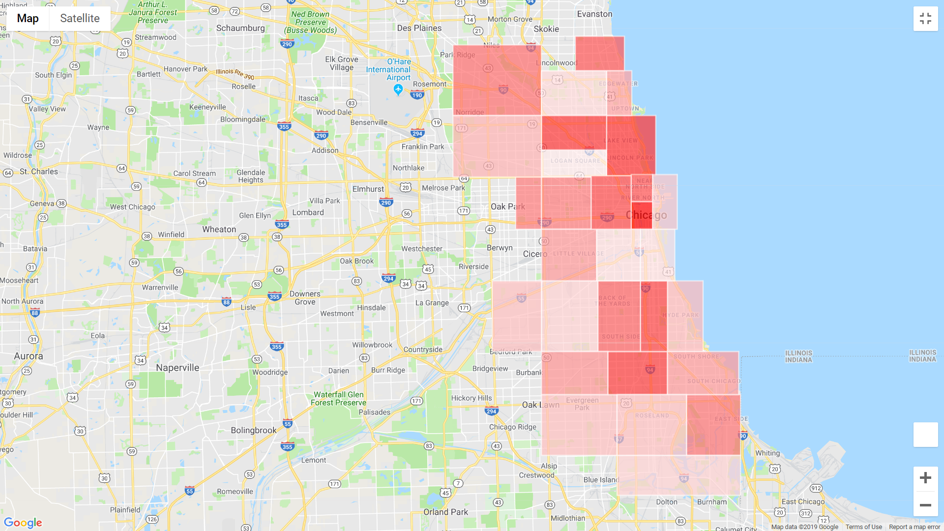
Traffic Crashes involving Drunk Drivers
Fewer Crashes | More Crashes
Choropleth map of traffic crashes involving drunk drivers (BAC > .08) in the City of Chicago, by region

Slide 21
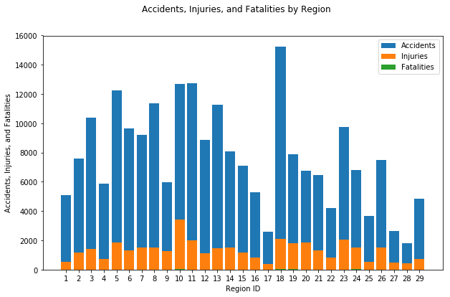
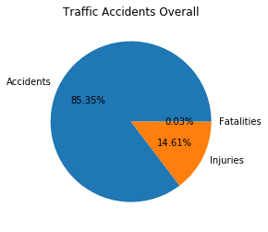
Accidents, injuries, and fatalities by region
14% of accidents result in injuries
.03% of accidents result in fatalities

Slide 22
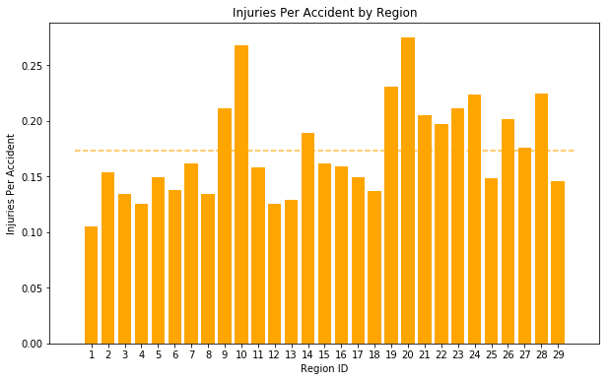
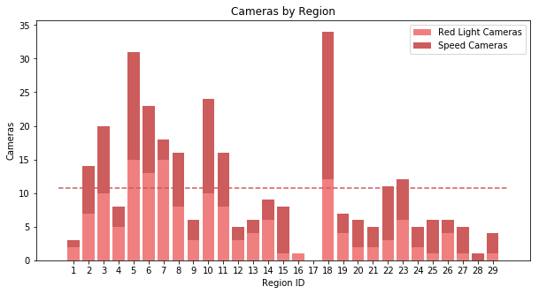
Injuries Per Accident by region
Region 10: Garfield Humboldt Park E/W
High injuries per accident
High fatalities per accident
Higher than average amount of traffic cameras (24)
Highest number of speeding violations per crash in the dataset
Region 20: Fuller-Grand Blvd- Washington Park
High injuries per accident
High fatalities per accident
Lower than average among of traffic cameras (7)

Slide 23
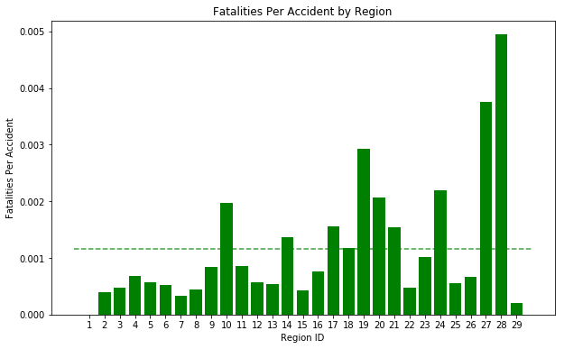
Fatalities By Region
Region 1: Rodgers Park- West Ridge
Lower than average injuries per accident
Zero fatalities per accident
Lower than average amount of traffic cameras (3)
Region 28: Riverdale-Hegewisch
Higher than average injuries per accident
Highest fatalities per accident
Lower than average number of traffic cameras (1)

Slide 24
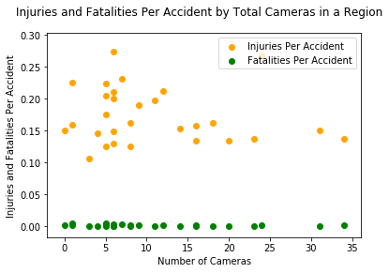
Correlation between injuries, fatalities, and cameras
Number of traffic cameras is not an accurate predictor of injuries and fatalities
P values
Injuries: .5
Fatalities: .19
R values
Injuries : -.13
Fatalities : -.25

Slide 25
Conclusions and further questions
Conclusions
Further Questions and Areas of Research
Strong correlation between crashes and traffic cameras by region
Strong correlation between congestion and crashes by time of day
No correlation between severity of accidents and traffic cameras
Certain areas have a higher incidence of drunk driving and speeding
Historical crash data pre-traffic cameras
More reliable traffic congestion estimate
Additional comparisons between regions and crashes (cause, ages, weather, etc.)
Comparisons to other cities

Slide 26
Questions

Slide 27
Possible Uses
Public safety
Identify regions with disproportionately low camera-to-crash ratio and install additional cameras accordingly
Insurance companies
Identify risk of car crashes in a given region of the city
General public
Identify regions with more frequent crashes
Law enforcement
Increase DUI enforcement in regions with more crashes involving drunk drivers

Slide 28
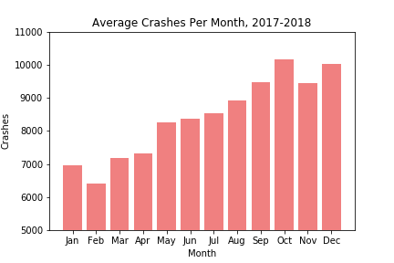
Average Crashes Per Month
Trend of increasing crashes, with the lowest level in February and increasing into the end of the year.

Slide 29
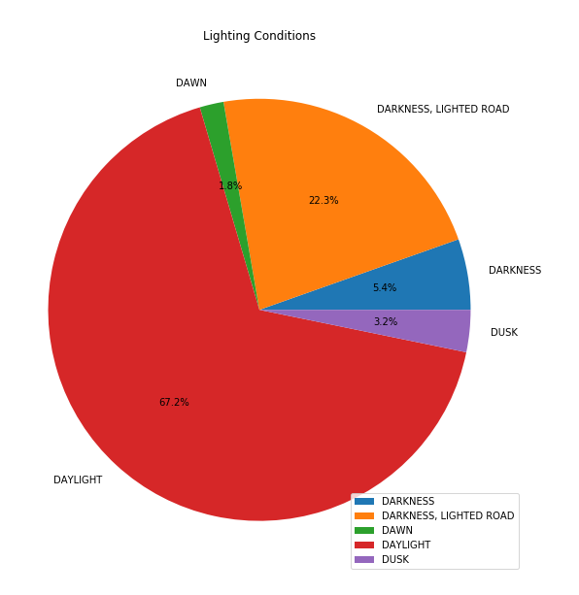
Crashes by Lighting Condition
67.2% of crashes happen in daylight
32.8% of crashes happen in lighting conditions with less visibility (dawn/dusk/night)

Slide 30
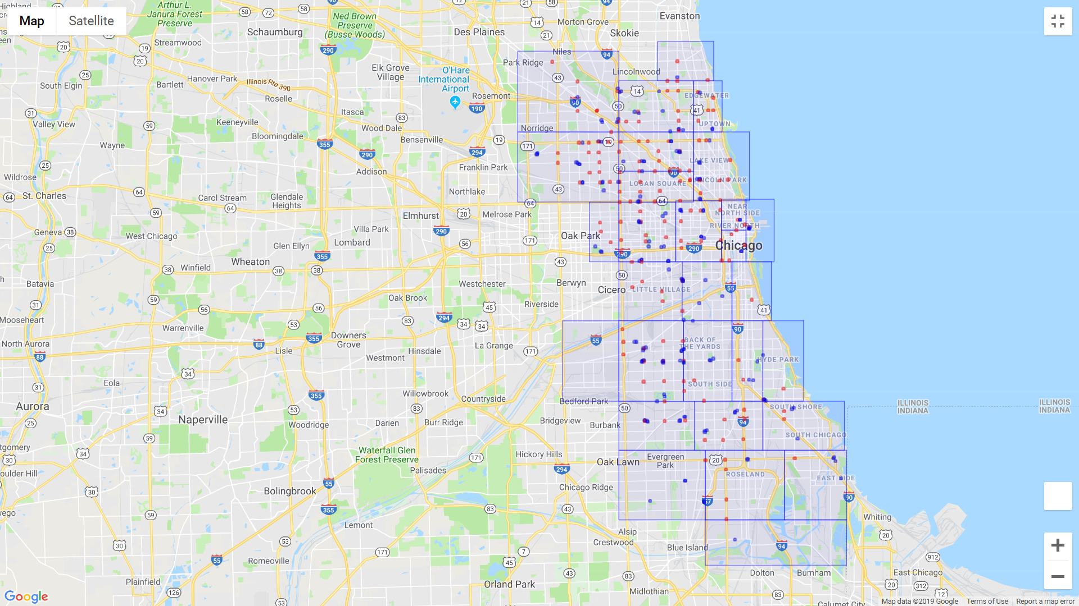
Traffic Regions, Incl. Red Light and Speed Cameras
Red Light Cameras
Speed Cameras
29 regions, defined by the City of Chicago

